Slide 1


Snowtime
2023 / 2024
What to do in & around Zurich in Winter
With Medical Advice from Dr Angela Caddick www.NewInZurich.com
Christina Fryer

Slide 2
Useful Numbers
- Police
- Firebrigade
144 - Ambulance
1414 - REGA Swiss rescue
044 360 44 44 - 24 Hour SOS Emergency doctors - https://www.sos-aerzte.ch/en/
- Breakdown rescue for cars

Slide 3
Winter Essentials
The Basics – House & Car
House & Garage
Access on pathways, oil for heating etc
Your car:
Winter tyres
Snow-chains
Anti-freeze
2023 Vignette
Travelling:
Shovel
Snacks & drinks
Blanket
Mobile phone & charger
Coins, cash & cards
Always check forecast before long journeys
Clothes
Winter Layers
Waterproof & non slip boots
Clip on crampons for shoes

Slide 4



Slide 5
Winter Essentials
You and the kids
Snow proof footwear & clothing
Ski wear
Family Ski Insurance (& check visitors) & REGA insurance approx 80 CHF for family www.rega.ch
Plan your February “Ski Week” – book accommodation, ski lessons,
creche care early!
Book Winter accommodation early!
ICS Ski & Snowboard
Academy at Hoch Ybrig
Join the ICS Ski Club for Parents

Slide 6




Slide 7
Zurich Autumn / Winter Events 1
Zurich Wine Festival 16th – 22nd Oct at Papiersaal Sihlcity
Fondue Tram 1st November – 29th February
JazzNoJazz Music Festival – 1st – 4th November
Auto Zurich Car Show 2nd – 5th November
Expovina – Wine Ships at Bürkliplatz 2nd – 16th Nov
Honold’s Chocolate Tram – Schoggi Tram 3rd – 12th Nov
SPORT SHOP TIMEOUT Uster Season Opening: Ski & Snow gear deals & Special offers
The Illuminarium – 9th November till 30th Dec (except 24th & 25th Dec) & Sunday Children`s Disco 3pm to 5pm
Kerzenziehen – Candle making at Bürkliplatz 11th November – 20th December
Räbeliechtliumzug Richterswil, biggest in Europe 11th November
Bickfang Design Fair at Kongresshaus Zurich 17th – 19th November
Live on Ice Skating – Sonne Romantik SeeHotel Kuesnacht 18th November – 28th January
Räbeliechtliumzug in local villages – check individual locations
Jelmoli’s Childrens’ Christmas Tram 25th Nov – 23rd Dec (except 26 Nov & 11 Dec)

Slide 8



Slide 9
Zurich Autumn / Winter Events 2
ICS Christmas Market
Lion King Disney the Musical IN ENGLISH at Theater 11, 23rd November – 10th March 2024
Zurich’s Christmas Lights go on at 6pm on 23rd November Christmas Tree at HB - 7pm 23rd November 2023
Visit the Swiss Christmas Markets begin 23rd Nov & mostly end 23rd - 24th Dec
Visit the Singing Christmas Tree (23rd November – 23rd December)
Zurich “night shopping” 23rd November 6pm – 10pm
Circus Conelli 23rd November – 31st December
Zauberpark at The Circle 23rd Nov – 10th Dec Music & art installations & Children’s programme
Samichlaus Procession Bahnhofstrasse – 26th Nov 5pm
Shopping Sundays Zurich 26th Nov, 3rd Dec & 17th Dec 11am - 6pm
Salto Natale Circus 29th November – 31st December
Musical Advent Calendar 1st – 23rd December 5.30pm Foyer of Opera House
Samichlaus Swimming in river Limmat 3rd December
Zurich Silvesterlauf 10th Dec (need to pre-book)
Lichterschwimmen - Candles floating in the Limmat Stadthausquai 21st Dec 6pm

Slide 10


Slide 11
More Winter Events
Fondue Cruise on Lake Zurich - Various dates
Enjoy a Fondue or Raclette – see our Guide
Pop up Fondue locations: eg Bernadette Gondolas next to the Zurich Opera, Marina Lachen on Lake Zurich, Tuk Tuk Fondue, Hirschen Am See in Meilen
Visit a snowy region not too far away? Stoos, Flumserberg, Flims/Laax, Arosa?
Go Snow shoeing – see our list of Snow Hikes on NewInZurich.com
Go Tobogganing – see the guide on NewInZurich.com
Ice skating rinks in Zurich region: Dolder, KEK near Zumikon, Dübendorf, Oerlikon
Visit Lindt Chocolate Museum or Kunsthaus (main exhbitions free on Weds at KH)
Take a self-guided Hot chocolate tour of Zurich: Honolds, Sprunglis, Vanini
Go to a French or German Christmas Market like Konstanz or Strasbourg Lenzerheide Magic Forest 15th Dec – 3rd Jan similar to Zauberpark (Music & Kids programmes, Artistic light installations)
Gstaad New Year Music 27th Dec – 9th Jan
Lake Zurich New Year’s Eve Fireworks start at 00.20am!

Slide 12
Christmas Markets
Swiss Christmas Markets:
Zurich Hauptbahnhof, Niederdorf, Bellevue Opera, Munsterhof, Frau Gerolds Garten, Enge, Zug, Baden, Rapperswil, Einsiedeln, Russikon: Mostly 23rd Nov – 23rd Dec (HB until 24th Dec)
German Christmas Markets:
Konstanz 30th Nov – 23rd Dec
Stuttgart 29th Nov – 23rd Dec
Munich 27th Nov– 24th Dec
Freiburg 23rd Nov – 23rd Dec
French Christmas Markets:
Colmar 23rd Nov – 29th Dec
Strasbourg 24th Nov – 24th Dec
See Christmas Markets Guide on
www.NewInZurich.com

Slide 13
Winter 2024 Events
Klosters New Years Day Pig Race 1st Jan 3 – 6pm
Andermatt New Years Music Belle Epoque Jan 1st from 4.30pm
PhotoSchweiz Halle 550 Oelikon 12th – 16th Jan
Luzern LiLu Lights 11th - 21st Jan
Lauberhorn Ski Race Wengen 12th -14th Jan
Visit the Kunsthaus and see the TIME from Duerer to Bonvicini till 14thJan 2024
International Balloon Festival Chateau d`Oex 20th Jan – 28th Jan. https://www.festivaldeballons.ch/en
Art on Ice, Hallenstadion 8th – 17th Feb
White Turf St Moritz 2024
Family Days 3rd, 10th , 17th Feb
Race days 4^{th,} 11th, 18th Feb
Zuri Carnival 16th to 18th Feb
ICE St Moritz (International Concourse of Elegance) 23rd – 24th Feb

Slide 14
Ski Clothing & Equipment
Hire or Buy?
Sports Shop Time Out Uster speak English & amazing service PLUS 10% “ICS discount”
You can hire skis and then buy if you like them
Under 12 Ski Hire Packages – very good value
Sport Shop Time Out also service skis & give advice on existing kit eg back protectors etc
Decathlon
Migros Sportxx
Och Sport
Ochsener Sport
Sportfabrik Outlet shop inVolketswil
Sport Pfister, Uster
Intersport
C&A, Manor, Globus, Jelmoli
Tchibo

Slide 15
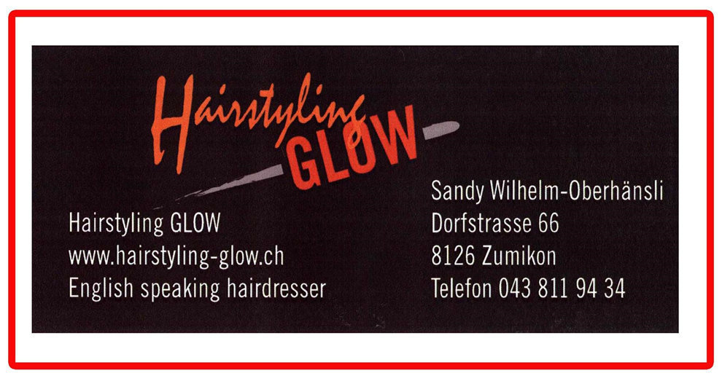
ICS / NewInZurich Offers:
Sport Shop Time Out in Uster offers all ICS Parents 10% discount on all purchases and has great ski hire deals for kids & they speak English. Pfäffikerstrasse 30, 8610 Uster Tel: 044 942 06 16 Website: www.sportshop-timeout.ch
SPORT SHOP TIME OUT SEASON OPENING SAT 4th NOV With Special deals and offers!
Pure Beauty Spa in Zollikon are English speaking and offers 20% off your first beauty treatment (on Weds, Thursdays & Fridays) if you mention NewInZurich. Zollikerstrasse 82, 8008 Zürich Tel: 043 544 31 31 Website: www.purebeautyspa.ch

Slide 16
Ski Equipment
Helmet
Backplate
Goggles & sunglasses
Skis & Poles / Snowboard
Key to Ski wear is layering:
Ski jacket & ski pants
Recco items / Inflatable backpack
Good quality Thermals/polo
Gloves (& Spares for car etc)
Glove liners / Glove warmers
Shoe chains
Ski boots
Snow boots with grips
Suncream & snacks & cash & coins!
Tips:
Label everything – even put stickers on skis!
If you have a new model of ski put peel off stickers on to differentiate
Have a Ski Check List (see last page) by the door before you set off for the slopes.

Slide 17
Ski Tickets and Season Passes
Choose a Resort & Check the Deals
Check Ski websites for Deals!!!
“Dynamic Pricing” is the new watchword at many resorts
Cheapest during the week and in advance
Most expensive when the weather is good andat weekends where there is high demand
Download ski ticket to rechargeable card or Swisspass
Basic Types of Ski Cards & Passes:
Day, ½ day cards - Season passes
Stundenkarte: 3 or 4 “hour” cards
Rechargeable cards (CHF 5 depo)
Family Ticket Deals:
Many deals include grown-up children
TopCard – Davos / Klosters, Flim Laax Falera & Lenzerheide /Arosa
Meilenweiss Card – Flumserberg & lots
-SnowPass – Graubunden & Ticketcorner & Swiss Pass – plastic cards you can load tickets on online
Season Tickets, Weekly, Monthly Can be loaded onto your Swisspass (SBB card)
www.bergfex.com - fantastic information on ski resorts

Slide 19
Ski Resorts Not Far From Zurich
Flumserberg :–
By Car to Gondola base station in Unterterzen or drive to car park top station
By train to Unterterzen
Klosters, Davos, Flims, Laax: –
Via Chur (watch for parking availability signposts on A3 near Landquart)
By train to Klosters
Davos Express bus from Zurich airport to Davos on Saturdays
Arlbergexpress bus from Zurich airport to St Anton & other resorts
Also look for Snow’n’rail Packages to resorts all over Switzerland and special ski, rail and hotel deals!
ICS Ski Groups
Don’t forget to join ICS Ski group

Slide 20




Slide 21
Kids Info and Ski Lessons
Tourist Office good source of information
Certain resorts awarded “ Families Welcome”
Creches & Babysitters for Infants
Kindergarten & Kids Clubs & Snow Gardens for Toddlers
Book ski lessons BEFORE you arrive in resort
Hotels with childcare – Kinderhotels, Robinson, Mark Warner, eg Club Med Tignes. Vald’isere, Val Thorens & Grand Massif France
Igloos (some are heated) in Davos, Engelberg, Gstaad, Zermatt & Schuls
Ski Lessons normally from 4 yrs +
Ask to be in English speaking lessons
Group lessons vs private lessons
School Lessons or lessons in your resort
Various ski school levels – kids village then blue, red, black
Label kids’ equipment, label clothes, label everything!!!
Booklet & medals
Snowboard Parks in Laax, Davos,
Hoch Ybrig, Lenzerheide

Slide 22


Slide 23
Winter Sports Quiz
https://www.urmc.rochester.edu/encyclopedia/content.aspx?contenttypeid=40&contentid=WinterSportsQuiz
Top Tips When Skiing
Professional instruction
Equipment check
Don’t borrow kit
Warm up and down properly
Fit to Ski
Recognise when you are tired
Stay within your limits
Dehydration
Clothing
Helmet
Don’t ski or board off-piste alone
FIS code

Slide 24


Slide 25
What to do in a Winter Sports Accident
DO
1. Summon professional help
2. Ensure that you, the scene and the casualty are safe
3. Assess conscious level and ABC
4. Immobilise the neck (spine) if necessary
5. Keep your casualty warm
6. Gather as much info as possible
7. Constantly reassess
8. Stay calm and reassure your casualty
DO NOT
1. Rush in without checking for safety
2. Move the casualty unless their life is in danger
3. Expose your casualty to the elements unless you have to
4. Remove neck immobilisation until professional help arrives
5. Remove the casualty's helmet unless their life is in danger
6. Remove the casualty's boot(s)
7. Give the casualty alcohol
8. Panic!
Tree Well / Deep Snow Conditions
Always maintain visual contact.
If you do fall into a tree well do not struggle but wait for help.
Cross skis to warn other skiers of accident & attract help

Slide 26
FIS Ski Rules
Respect for others
Control of speed and skiing
Choice of route
Overtaking
Entering starting and moving upwards
Stopping on the Piste
Climbing and descending on foot
Respect for signs and markings
Assistance
Identification
http://www.fis-ski.com/uk/insidefis/fisgeneralrules/10fisrules.html

Slide 27
Winter Activities For Non-Skiers
Mountain resort restaurants
Cross Country Skiing / Langlaufen
Snow-shoeing
Toboganning
Curling
Ice Skating – so many great venues in Zurich
Swimming, Thermal baths, Saunas, Wellness
Horse Drawn Sleigh rides e.g., Klosters, Grindelwald, Arosa, St Moritz, Zermatt,
Husky rides
Illuminarium - Swiss National Museum till 30th Dec
Kunsthaus (free on Wednesdays)
See a Musical –Simply Theatre Zurich
Ice Skating - Dolder, KEK near Zumikon, Dübendorf, Oerlikon, Sonne Hotel
Also skating on Sihlsee and sometimes on Lake Pfäffikon & Katzensee if it freezes
Thermal baths & wellness – Bad Ragaz, Baden, Schinznach, Zurich (Hurlimann), Dolder Grand
Panorama Resort Spa Feusisberg
Trips to Jungfraujoch, Schilthorn, Rigi, Matterhorn, Titlis, Gornergrat
Glacier Express train, St Moritz - Zermatt

Slide 28
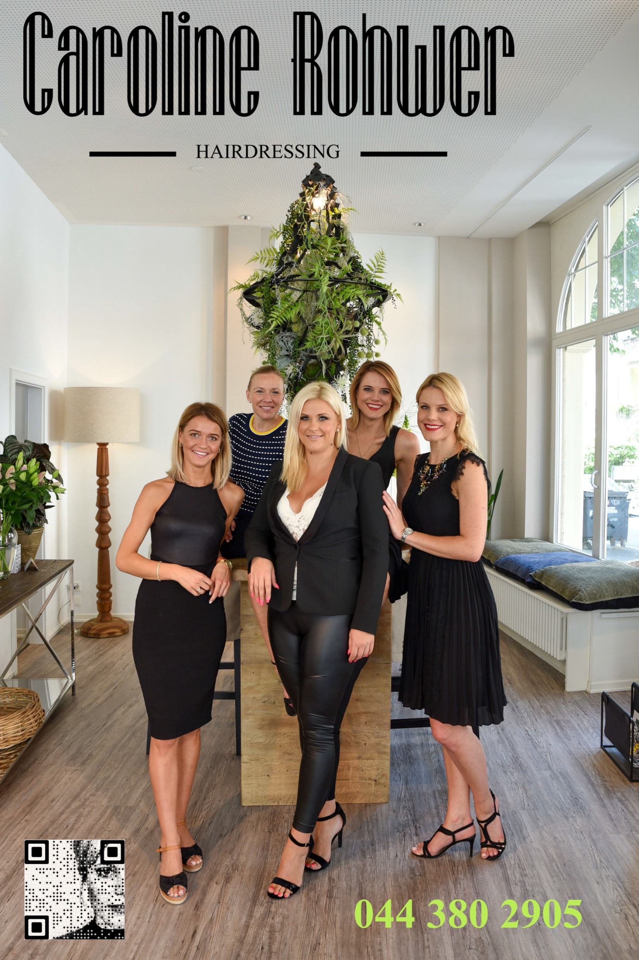

Slide 29
Christmas Food Etc.
Turkey – Farmy.ch, Migros, Coop, Globus, Jelmoli, Park Hyatt
Do check turkey will fit your small Swiss oven!
Christmas trees, Decorations & Lights:-
Garden centres & flower shops: (Rüti, Russikon), Florita in
Zumikon Dorfplatz, Ikea, Interio, Jelmoli, Globus, Migros,
Coop, Jumbo, Tchibo, Aldi
Christmas Delicacies:-
Christmas cards, crackers, biscuits, mincemeat etc. Orell
Fuessli (Fuesslistrasse 4) britshop.ch, myexpatshop.com,
afoodave.ch/ (American).
Stilton: The British Cheese Delia at Viadukt, Globus, Coop Volkiland
www.NewInZurich.com - events, what’s on in Zurich
www.bergfex.com - fantastic information on ski resorts
www.myswitzerland.com - ‘what’s on’ in Switzerland website
Sign up to NewInZurich.com for Special Offers & Contests
Special Offers at TimeOut Sports 10% off for ICS families

Slide 31
Ski Check List
Skis
Stickers to put on skis to differentiate or “mark” them
Snowboards
Ski ticket / Season Pass
Thermals
Ski Jacket
Ski pants
Helmet / helmet liner
Goggles
Sunglasses
Ski boots
Ski Socks
Ski poles
Balaclava / neck warmer
Gloves
Hand warmers for gloves
Back protector
Sunscreen
Piste maps
Coins & cash & credit cards
Water / drinks
Mobile phone / charger / power bank / in car charger
Snacks & drinks for the car journey
Spare gloves
Snowchains ( if needed)
Blanket / change of clothes
Shovel

